Slide 1


5. Plotly
Mrinal Vashisth
PhD Year 2, Computational Psychometrics, TSU, RF
M.Sc. Human Development: Genetics, Neuroscience and Psychology, TSU, RF
M.S. Applied Mathematics and Information Technology (Systems Biology and Bioinformatics), ITMO, RF
B.Tech. Biotechnology, JNU, RI

Slide 2
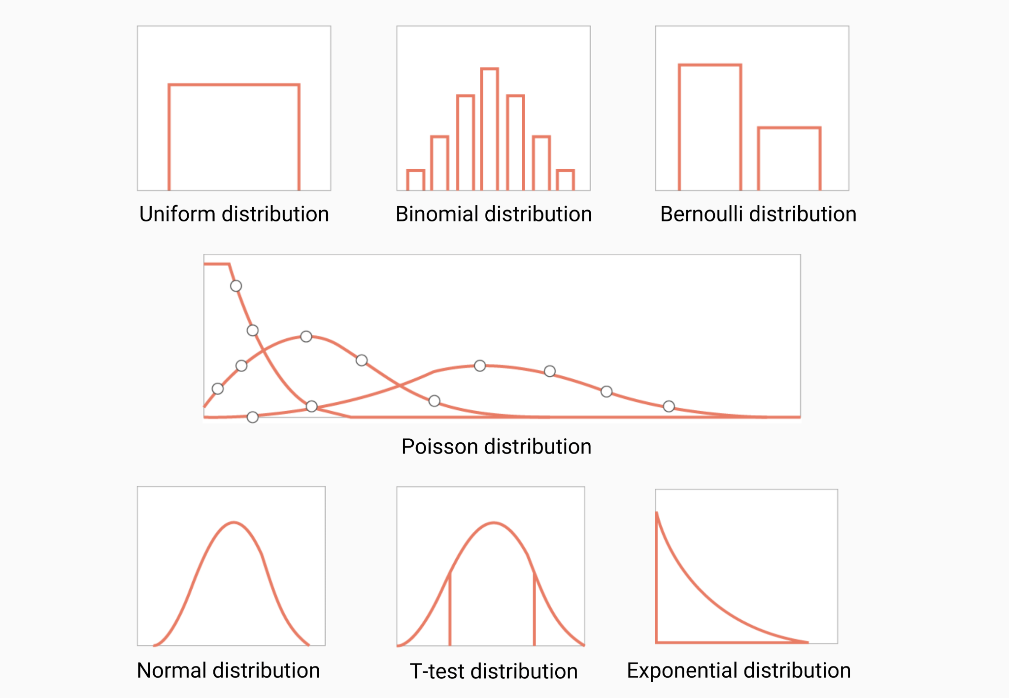
Visualization for exploration of patterns
How are mathematical realities represented in the computational world:
concepts, ideas, variables, factors, objects, name_spaces
https://pythontutor.com/render.html#mode=edit
This class itself is an example of visual and interactive way of learning things

Slide 3
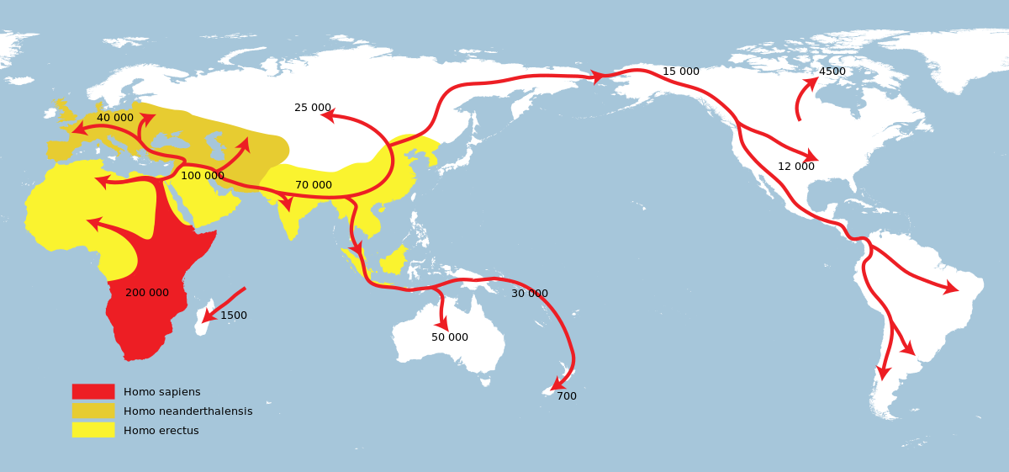
Hypothetical example
https://en.wikipedia.org/wiki/Recent_African_origin_of_modern_human
s

Slide 4
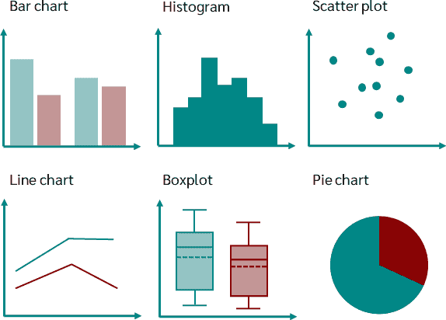
Why plots matter
https://datatab.net/tutorial/charts

Slide 5
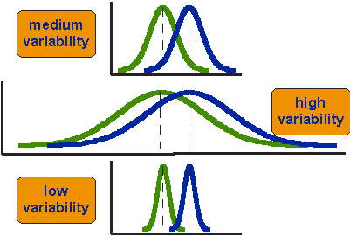
Analogy with statistical method selection (classification problem)
https://conjointly.com/kb/statistical-student-t-test/

Slide 6
Example: A small app
https://dash.gallery/dash-clinical-analytics/
Note: We will make our own app in the 7th session.
Let’s try to understand what plotly and dash are doing!
https://worldatlas.org/Absence-of-corruption-Index-(IDEA)/2018/bar
One of the best apps I have seen! Or maybe there are better! :)

Slide 7
Introduction to Plotly
https://plotly.com/python/figure-structure/
Let’s look at the documentation.

Slide 8
Go to jupyter notebook 5.
Assignment at the end of the notebook.

